Slide 1
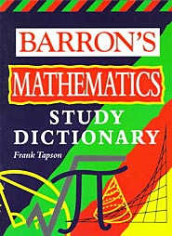
Quadratic Functions
A Quadratic Function is an equation that has the form
The graph of a Quadratic Equation is a u-shaped curve called a Parabola.
The Vertex is the highest or lowest point of the parabola.
The Vertex is also called the Turning Point.
If a is positive, the parabola opens upward, and the vertex is the minimum point.
Maybe we should look at some diagrams.
If a is negative, the parabola opens downward, and the vertex is the maximum point.

Slide 2
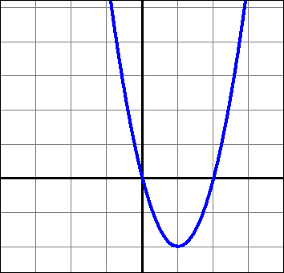
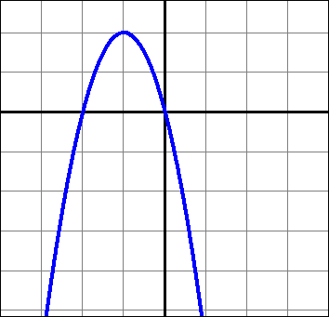
Maximum and Minimum Points
a is positive, therefore the parabola opens upward, and the vertex is the minimum point.
a is negative, therefore the parabola opens downward, and the vertex is the maximum point.
(-1, 2)
Vertex
Turning Point
Vertex
Turning Point
(1, -2)

Slide 3


Axis of Symmetry
The Axis of Symmetry of a parabola is the line that splits the parabola in half lengthwise. The Axis of Symmetry always goes through the Vertex of the parabola.
Let’s look at some graphs.
Axis of
Symmetry
Axis of
Symmetry
x = -1
x = 1

Slide 4

Finding the Axis of Symmetry
You can find the Axis of Symmetry of any quadratic equation by using the formula
Let’s take a look at those equations again.
To find the coordinates of the vertex, plug the value of x into the original function .
a = 2, b = -4, c = 0
a = -2, b = -4, c = 0
vertex
(1, -2)
vertex
(-1, 2)

Slide 5
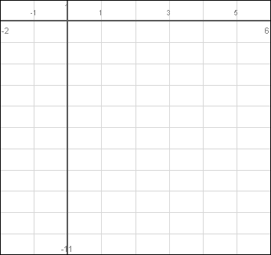
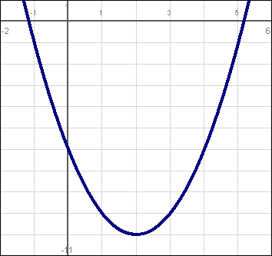
Graphing a Quadratic Equation Using a Table of Values
Graph
in the interval
Axis of
Symmetry
x = 2
That was easy
Vertex
(2, -10)

Slide 6

Graphing Examples

Slide 7
Quadratic Functions Homework
Page 156:
1 – 4, 6
Answer all questions on the graph paper.
Show all your work

Slide 8
Solving Quadratic Equations
When you solve a quadratic equation, the x values that you calculate are referred to as the roots of the equation.
When a quadratic function is in the form of , the roots can be found by setting the equation equal to zero and solving.
When a quadratic equation is factorable, then it can be solved algebraically.
Sometimes, the roots of the equation are referred to as the solution set.
This is actually pretty easy. Let’s look at some examples.

Slide 9
Factoring and Solving Quadratic Equations
Find the solution set of the following quadratic functions.
Rewrite the equation in ax² + bx + c = 0 format.
Rewrite the equation so that a is positive.
Factor the equation.
Set each factor equal to zero and solve.
Write the solution set.

Slide 10
More Factoring Examples
For what values of x is the following fraction undefined?
Solve the following equation for x
Cross-multiply.
If the denominator was equal to zero, the fraction would be undefined.
Rewrite the equation in ax² + bx + c = 0 format.
Factor the equation.
The fraction would be undefined at

Slide 11
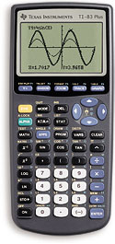
Solving Quadratic Equations by Graphing
Find the roots of the following quadratic function.
1) Enter the equation in Y₁ .
2) View the graph by pressing
GRAPH
Let’s solve by factoring first.
3) Press
2nd
CALC
2
(zero)
4) Move the curser slightly to the left
of the vertex and press
ENTER
Now let’s solve by graphing.
5) Move the curser slightly to the right
of the vertex and press
ENTER
6) Press
ENTER
The calculator calculates the 1st root.
Repeat steps 3 – 6 to calculate the 2nd root.

Slide 12
More Solving Quadratic Equations by Graphing
Approximate the roots of the following quadratic function to the nearest hundredth.
1) Enter the equation in Y₁ .
2) View the graph by pressing
GRAPH
3) Press
2nd
CALC
2
(zero)
Set equation equal to zero.
4) Move the curser slightly to the left
of the vertex and press
ENTER
5) Move the curser slightly to the right
of the vertex and press
This equation is unfactorable, so we have to use our calculator.
ENTER
6) Press
ENTER
The calculator calculates the 1st root.
Repeat steps 3 – 6 to calculate the 2nd root.
Round off your answer.

Slide 13
Solving Quadratic Equations with no Middle Term
Let’s check with our calculator to make sure the roots are correct.
Let’s check with our calculator to make sure the roots are correct.
Since there is no middle term, this equation is unfactorable.
Approximate the roots of the following quadratic function to the nearest hundredth.
That was easy

Slide 14
Linear Quadratic Systems
Algebraically
Graphically
Y₁ =
Y₂ =
View the graph by pressing
GRAPH
Press
2nd
CALC
5
(intersect)
Press
ENTER
ENTER
ENTER
The calculator calculates the first point of intersection.
Repeat the same process . Be sure to move the curser closer to the second point before pressing enter.

Slide 15
Projectile Motion
A ball is thrown in the air so that its height, h, in feet after t seconds is given by the equation
a. Find the number of seconds
that the ball is in the air
when it reaches a height of
128 feet.
b. After how many seconds will
the ball hit the ground?
Maybe we should check this on our calculator.
The ball reaches 128 feet at 1 second and at 8 seconds.
The ball hits the ground after 9 seconds.

Slide 16
More Projectile Motion
A model rocket is launched from ground level. At t seconds after it is launched, it is h meters above the ground, where
What is the maximum height, to the nearest meter, attained by the model rocket?
I know how to do this.
We need to find the maximum height. So, first we’ll find the axis of symmetry, then use that x-value to find the corresponding y-value.
The maximum height is approximately 240 meters.

Slide 17
Maximizing the Area of a Rectangle
Stanley has 30 yards of fencing that he wishes to use to enclose a rectangular garden. If all the fencing is used, what is the maximum area of the garden that can be enclosed?
x
Let x represent the length and let w represent the width.
15 - x
Let A(x) represent the area of the rectangle.
Since all the fencing must be used, the perimeter of the garden will be 30 yards, and we can use the following equation.
The maximum value occurs at
The maximum area is 56.25 yards².

Slide 18
Quadratic Equations Homework
JUN04 4, 30
AUG05 1
JUN06 27, 32
AUG06 3, 11

